Slide 1

ENV 501 / GR A3 30 MFA Software – Tutorial STAN
Teaching assistant:
Jair Campfens jair.campfens@epfl.ch
Fall 2024

Slide 2
Software for MFA
Tools for mapping and calculating mass balance systems
STAN (STofflussANalysen) by TU Wien, Institut für Wassergüte, Ressourcenmanagement und Abfallwirtschaft
Free software available at: http://www.stan2web.net/downloads/stan
Umberto
Others
Matlab (Toolbox Simulink)
Mathematica
R

Slide 3
What is STAN?
subSTance flow ANalysis
Free software for material flow analysis (based on Austrian standard ÖNorm S 2096; MFA − application in waste management)
Available in EN or DE
You can use STAN to:
Build graphical models with predefined components (processes, flows, system boundaries etc.)
Enter or import known data (mass flows, stocks, transfer coefficients etc.) for different layers and periods
Produce Sankey-style diagrams
Consider data uncertainty and error propagation
(Source: www.stan2web.net, 2019)

Slide 4
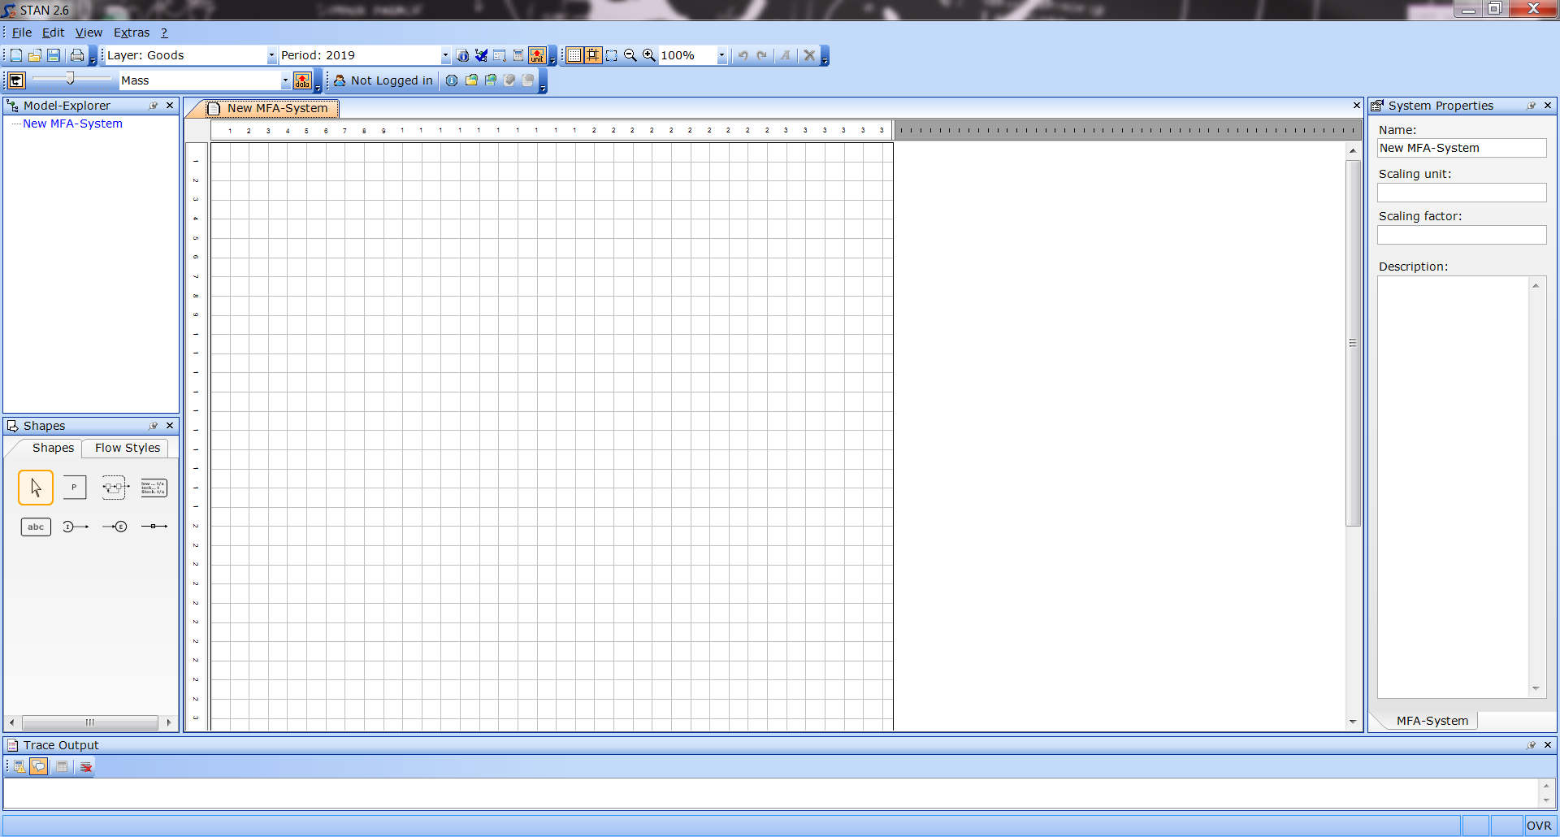
Menu toolbars
Drawing area (DA)
Properties Window
Shapes Window

Slide 5
To get started…
File management
Open new document [Ctrl + N]
Open existing document [Ctrl + O]
Save document (.zmfa file) [Ctrl + S]
Use the STAN web platform can for file exchange between users:
Login to STAN portal directly from program
Possibility to Load/Save/Delete/Modify STAN files via portal

Slide 6
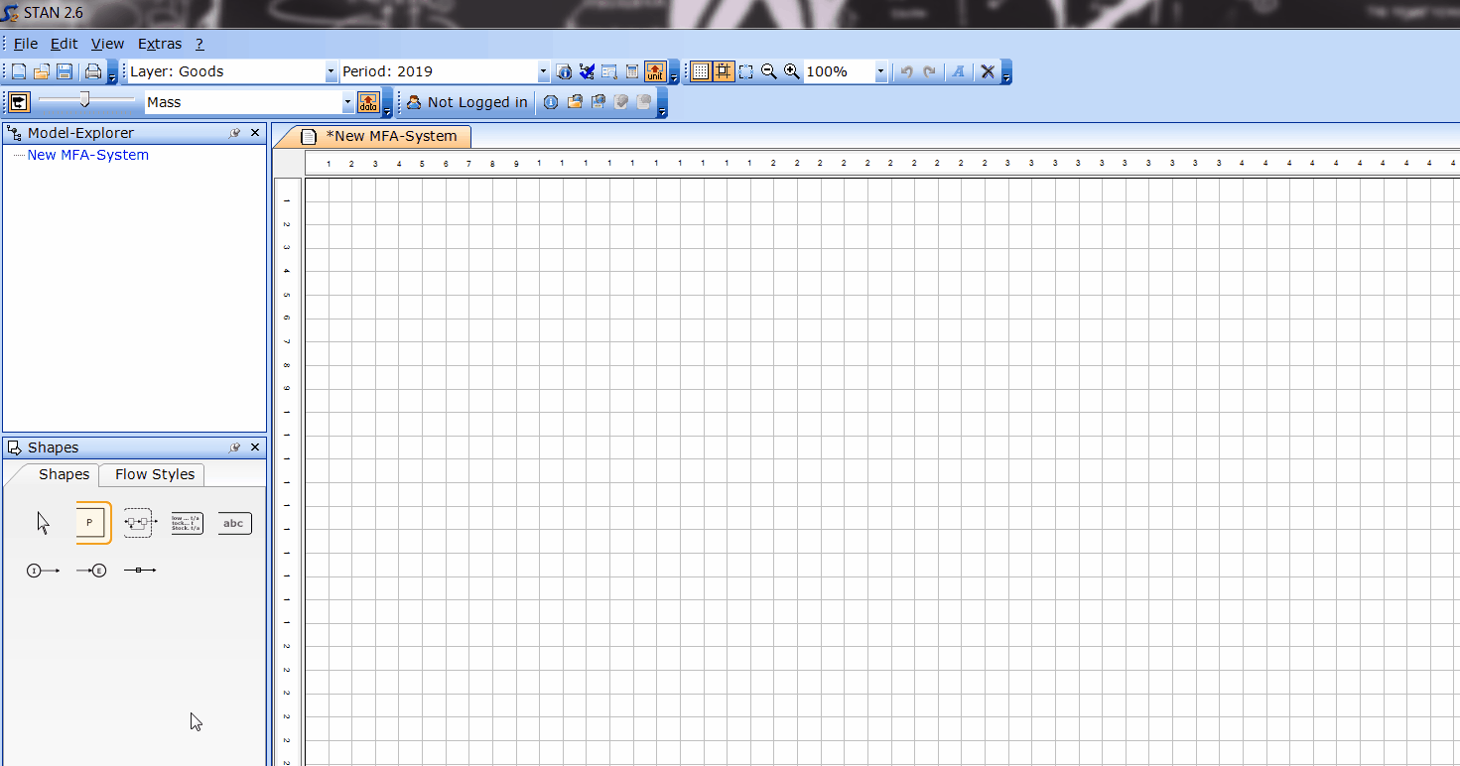
Inserting a process
Click on in the Shapes window
Click to drop at desired position
Processes can be resized/moved in the DA, and assigned values and renamed/modified in the Properties window
P

Slide 7

Inserting a flow between processes
Click on in the Shapes window
Click to drop at Process 1 and drag to Process 2
Flows can be assigned values and renamed/modified in the Properties window

Slide 8
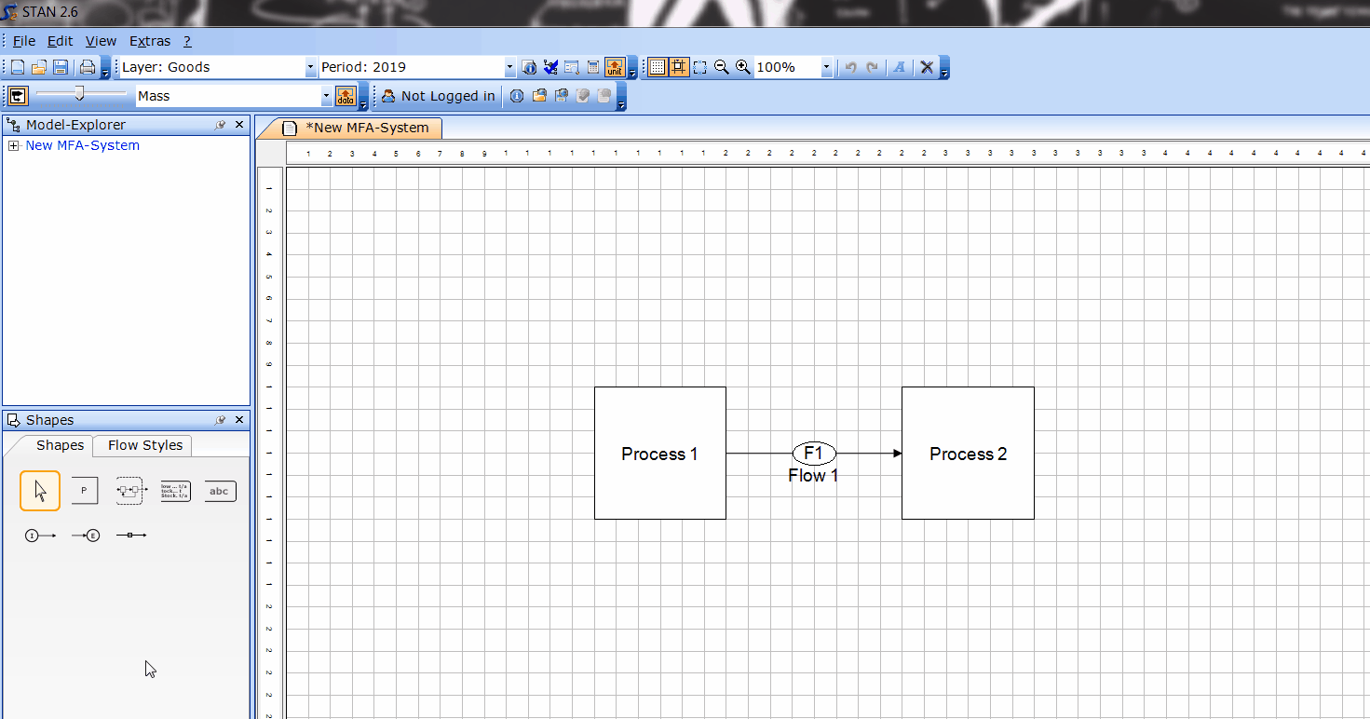
Inserting import/export flows
Click on or in the Shapes window
Click to drop in DA and drag to the relevant process
Import and export flows can be assigned values and renamed/modified in the Properties window
I
E

Slide 9

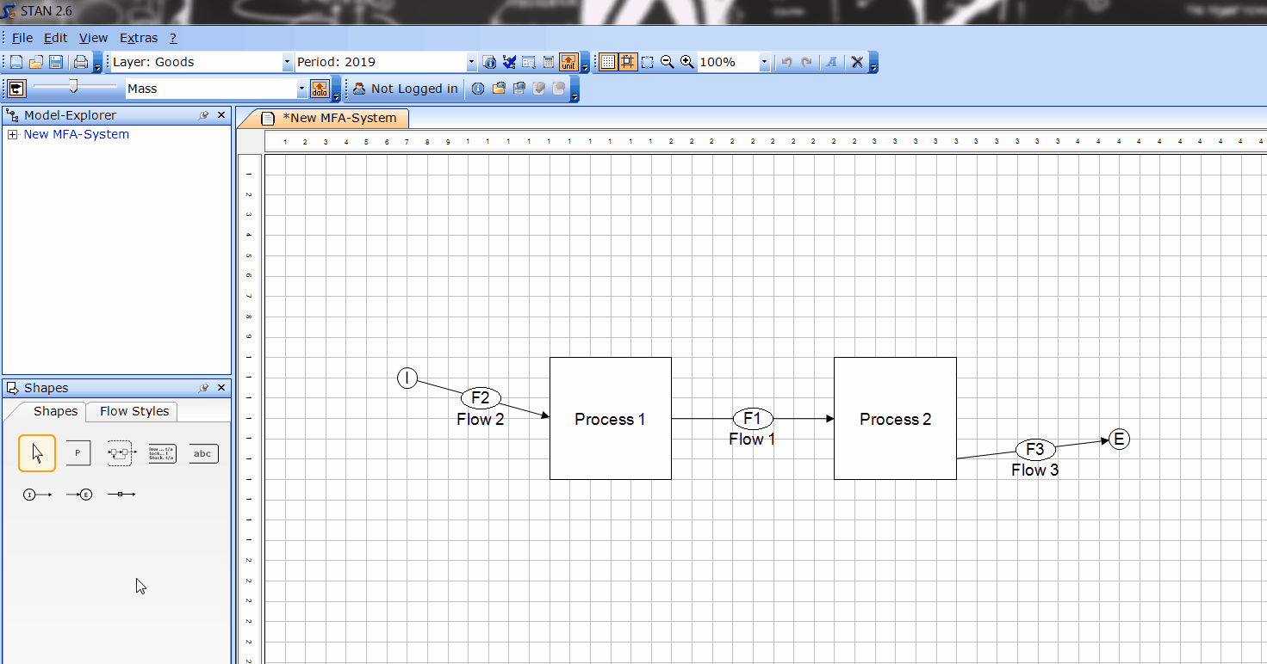
Defining the system boundary
Click on in the Shapes window
Click to drop in DA and drag over the relevant processes and flows
System boundary will be refreshed automatically with the change in stocks and the sum of imp/exp when data values are defined

Slide 10
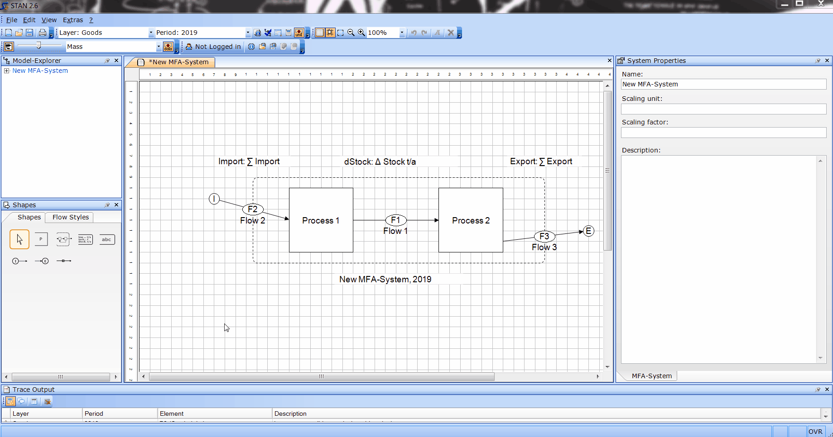
Properties window
Defines values for flows, stocks, transfer coefficients and other details

Slide 11
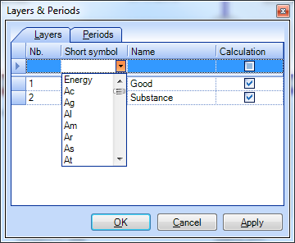
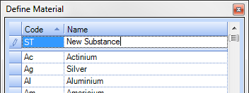
Other important elements
Layers
Layers can be used to organise different types of goods/substances
To create a new layer: Edit > Layers and Periods > Layers
Choose a substance/material from the list
Additional substances can be added to the predefined list: Edit > Define Material

Slide 12
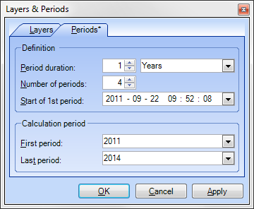
Other important elements
Periods
Periods can be defined to perform analysis over multiple time periods
To edit period information: Edit > Layers and Periods > Periods
Modify the parameters as desired
Default period for new projects is the current year
If multiple periods are considered, they must have the same duration and be consecutive

Slide 13
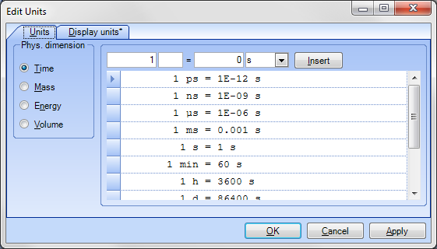
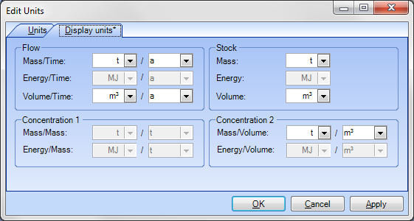
Other important elements
Units can be selected, defined, and modified via Edit > Define Units

Slide 14
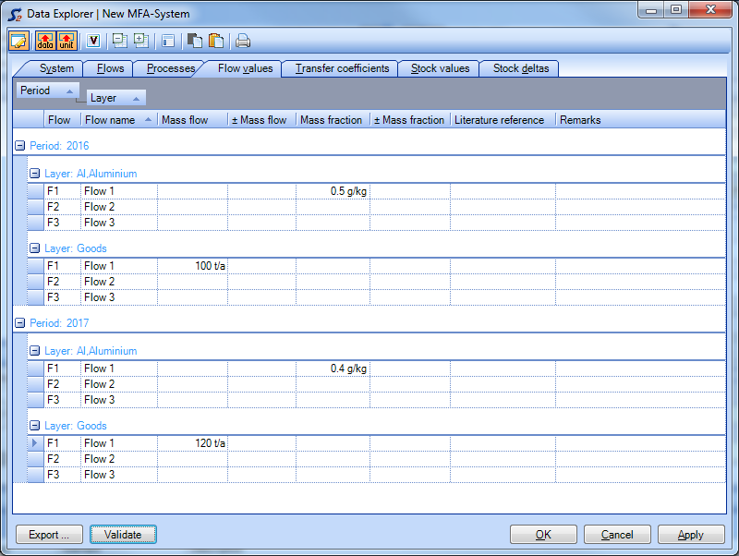
Data Import & Export
Edit > Data Explorer [Ctrl + D]
To edit data, edit mode must be switched on
Data can be entered for processes, flows, transfer coefficients etc.
Data can be copied to/from clipboard
Data can be imported from and exported to Excel

Slide 15
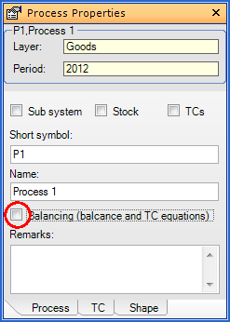
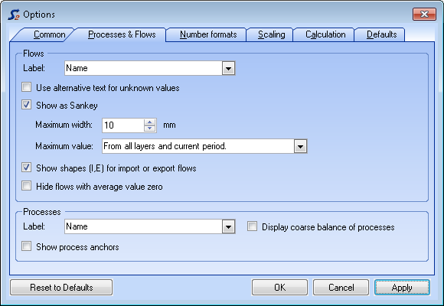
Calculation
Calculation procedures in STAN can include:
data reconciliation
computation of unknown quantities
calculation of uncertainties
Before calculation, consider:
Layer & Period selection
Edit > Layers and Periods
Processes to exclude from balancing
Display of coarse (mass) balance of processes within process icons
Extras > Options > Processes & Flows

Slide 16
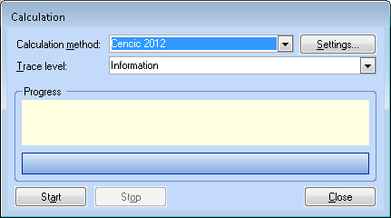
Calculation
To perform simple calculation, press F5 or click in the Data Input toolbar
Additional calculation options (calculation method, trace level) can also be defined if necessary
Edit > Calculation dialog

Slide 17
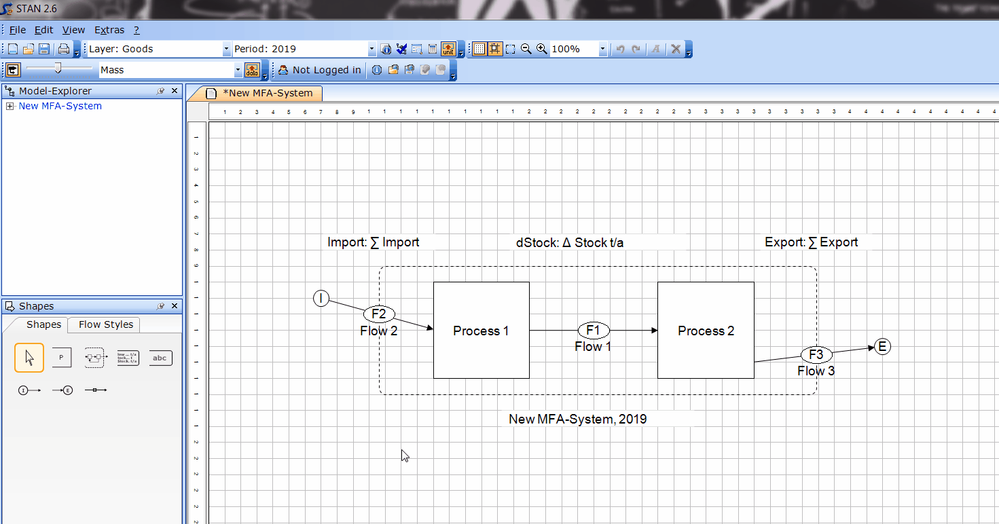
Export system diagram
File > Export Diagram
Select graphical options
Copy to clipboard or export as file

